Slide 1
CELLULAR MOBILE COMMUNICATION
P.RAJESH M-Tech.,
Dept of ECE
CRIT ENGG college

Slide 2
Unit – 2 elements of cellular radio system design
General description of the problem:-
based on concept of efficient spectrum utilization the cellular mobile system design can be broken in to many elements .
the concept of frequency resuse channels
The co channel interface reduction factor
The desired carrier to interface ratio
The handoff mechanism
Cell splitting

Slide 3
Since limitations in the system is frequency resource the challenge is to serve the greatest no:- customers with a specified system quality.
i) how many customers can we serve in a busy hour?
How many subscribers can we take in to our systems ?
How many frequency channels do we need?

Slide 4
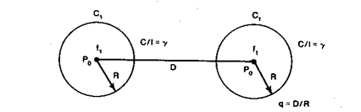
a) Concept of frequency reuse channels
In the frequency reuse system the same frequency of cellular mobile radio system can be utilized by the users in different geographical.

Slide 5
The frequency reuse system can drastically increase the spectrum efficiency but if the system is not properly designed serious interface may occur interference due to common use of same channel is called co channel interference.
Frequency reuse schemes:-
the frequency reuse is used in time domain & space domain .
i) TIME DOMAIN:-
The frequency reuse in time domain results in the occupation of the same frequency in different time slots which is known as TIME DIVISION MULTIPLEXING (TDM).

Slide 6
ii) space Domain:-
divide in two categories.
Same frequency assigned in two different geographic areas same frequency assigned.
Same frequency repeatedly used in same general areas in one system.
Frequency reuse Distance :-
Depends on following factors
1. no of co-channel cells in the vicinity of the center cell
2. type of geographic terrian contour
3. transmitted power at each cell site
4.Height of antenna

Slide 7
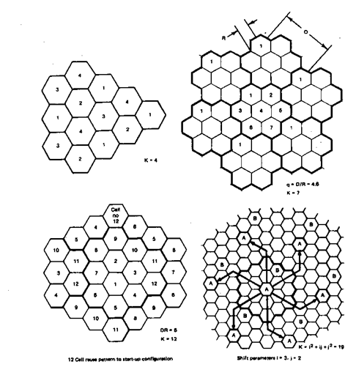

Slide 8

Where K is the frequency reuse pattern
R

Slide 9
2. Co-channel interference reduction factor
Reusing an identical frequency channel in different cells is limited by co-channel interference between cells, and the co-channel interference can become a major problem.
Assume that the size of all cells is roughly the same.
The cell size is determined by the coverage area of the signal strength in each cell.
As long as the cell size is fixed, co-channel interference is independent of the transmitted power of each cell. It means that the received threshold level at the mobile unit is adjusted to the size of the cell. Actually, co-channel interference is a function of a parameter q defined as
q = D/R

Slide 10
D= frequency reuse distance
R= coverage radius
q= co-channel interference reduction factor
When q is increased the C/I decereases
D is a function of Ki and C/I
D = f( Ki,C/I)
Ki = no of co-channles interfacing cells in first tier.
C/I is recived carrier to interference ratio at desired mobile reciver.

Slide 11

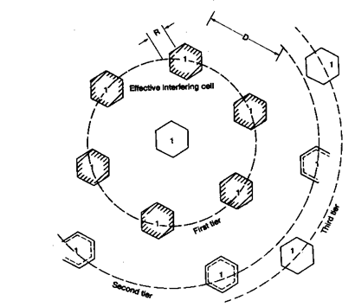

Slide 12

In a fully equiped hexagonal shaped cellular system there are always six co-channel interfacing cell in the first tier Ki = 6 cells
The carrier to interfering ratio (C/I) at mobile units caused by 6 interfacing sites is same as the carrier to interface ratio received at cell center cite by interfering mobile unit
Assume that the local noise is much less than the interference level and can be neglected. C/I then can be expressed as

Slide 13

= is a propagation path-loss slope determined by the actual terrain environment
usually is assumed to be 4. K is the number of co channel interfering cells and is equal to 6 in a fully developed system
The six co channel interfering cells in the second tier cause weaker interference than those in the first tier. Therefore, the co channel interference from the second tier of interfering cells is negligible Where

Slide 14

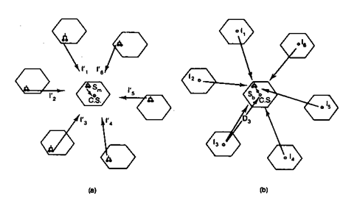

Slide 15

Desired carrier to interference ratio
2 cases can be considered
i) the signal and co-channel interference recived by mobile unit
Ii) the signal and co-channle interference recived by cell site
as long as the received carrier to interference ratio at both mobile unit and cell site are same the system is called as balanced system.
Balanced system cariier to noise ratio is

Slide 16

= A constant depends on terrain environment
Q= interference reduction factor

Slide 17
Cell splitting
The motivation behind implementing a cellular mobile system is to improve the utilization of spectrum efficiency.
The frequency reuse scheme is one concept, and cell splitting is another concept.
When traffic density starts to build up and the frequency channels Fi in each cell Ci cannot provide enough mobile calls, the original cell can be split into smaller cells.
Usually the new radius is one-half the original radius.
There are two ways of splitting:

Slide 18
New cell radius = Old cell radius/2
Then, New cell area = Old cell area/4
Let each new cell carry the same maximum traffic load of the old cell, then
New traffic load / Unit area = 4 X[ Traffic load/Unit area].
There are two kinds of cell-splitting techniques:
1. Permanent splitting:
The installation of every new split cell has to be planned ahead of time; the number of channels, the transmitted power, the assigned frequencies, the choosing of the cell-site selection, and the traffic load consideration should all be considered.

Slide 19
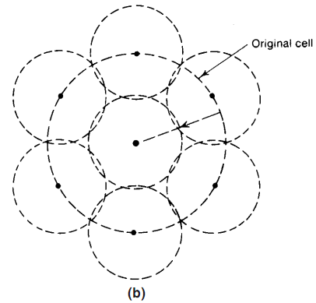
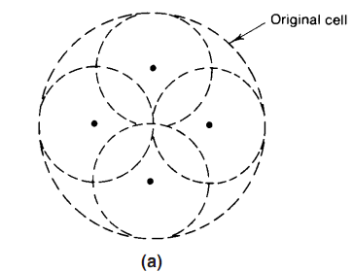
2. Dynamic splitting:
This scheme is based on using the allocated spectrum efficiency in real time. The algorithm for dynamically splitting cell sites is a tedious job, as we cannot afford to have one single cell unused during cell splitting at heavy traffic hours.

Slide 20
Hand-off Mechanism:
Hand-off is the process of automatically changing the frequencies.
When the mobile unit moves out of the coverage areas of a particular cell site, the reception becomes weak.
At this instant the present cell site requests Hand-off, then system switches the call to a new frequency channel in a new cell site without interrupting either call or user.
This phenomenon is known as “hand -off’ or ‘handover’. Hand -off processing scheme is an important task for any successful mobile system.
This concept can he applied to one dimensional as well as two dimensional cellular configurations.

Slide 21
By the reception of weak signals from the mobile unit by the cell site, the Hand-off is required in the following two situations.
They are
1. The level for requesting a Hand-off in a noise limited environment is at the cell boundary say-l00 dBm.
2. In a particular cell site, when the mobile unit is reaching the signal strength holes (gaps).Figure below shows the usage of frequency F1 in two cochannel cells which arc separated by a distance D.
Now, we have to provide a communication system in the whole area by filling other frequency channels
F2,F3 and F4 between two co-channel cells.

Slide 22
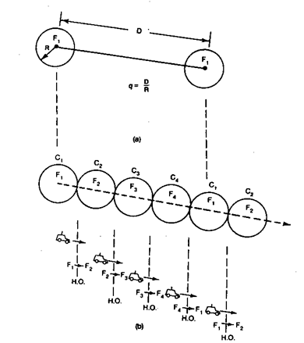

Slide 23
Depending on the same value of q the cells C2 ,C3 and C4 to which the above fill-in frequencies F2, F3 and F4 are assigned respectively.
Initially a mobile unit is starting a call in cell with fill-in frequency F1 and then moves to a cell with fillin frequency F2. The mobile unit moves from cell C1 to cell C2, meanwhile however the call being dropped and reinitiated in the frequency channel from F1 to F2.
This process of changing frequencies can be done automatically by the system without the user’s intervention. In the cellular system the above mentioned Hand-off process is used.

